Slide 1


Statistics Intro
AC52012: Research Methods
Notes:
Hello and welcome to the first video on Statistics in this first part of the Research Methods module, where we’ll be looking at quantitative research – that is, research that deals with numbers and facts.

Slide 2
WHAT IS STATISTICS?
the science of…
Planning studies and experiments
Obtaining data
Organising, summarising, presenting, analysing and interpreting this data
Drawing conclusions about the data based on the above
Notes:
A good place to start is with a definition of what statistics actually IS.
You’ll often hear ‘statistics’ in the context of facts and numbers about something, like statistics or ‘stats’ about the University of Dundee. And that is one definition of statistics.
However, as a discipline, statistics is a branch of mathematics that can be summarised as shown on the slide.
In the first part of this module at least, we’ll be concerning ourselves with describing data and drawing conclusions from it. For the most part, we’ll be looking at existing data that has already been gathered for us.

Slide 3
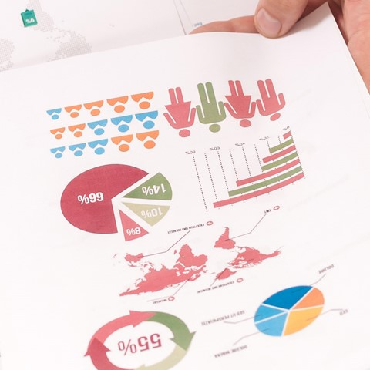

WHAT IS DATA?
“Collections of observations, such as measurements, genders, or survey responses”
- Triola (Elementary Statistics)
“a collection of discrete values that convey information, describing quantity, quality, fact, statistics, other basic units of meaning”
- Wikipedia
“basically everything”
- Daniel
Notes:
And it might seem obvious, but it’s also worth having a think about what ‘data’ actually is. Again, it’s a word that gets used for different purposes with different definitions, so it is useful to pin down a couple of these definitions for the purpose of this module.
In the course textbook, data is defined as shown on the slide. Wikipedia has a similar definition, making use of the word ‘collection’ again to imply that data is something that is collected about a person, a place, an opinion, an event, a relationship, or some other entity or phenomenon. The dictionary even defines data as ‘statistics’, which for our purposes isn’t quite correct. Statistics are what we get from analysing the data.
But, fundamentally, data can be ANYTHING. It can be numbers, text, images, audio, video, describing whatever it is that you’re interested in studying. We’ll be looking at a variety of data sets over the next few weeks, and it will be useful to think about the different ‘types’ of data and what they can be used for.

Slide 4
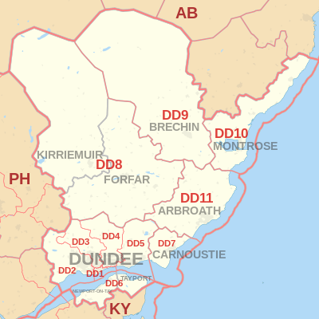


NOMINAL DATA
Mutually exclusive categories
Also called ‘categorical data’
Equivalence relationship, but no other meaningful comparisons
Used for frequencies and percentages (40% Scottish, 60% Irish)
Notes:
Nominal data identify mutually exclusive categories. So basically, the data is given a name, but there’s no way to order them.
For example, colours, postcodes, nationalities. So there’s an equivalence relationship, we can say that two people are Scottish, or two locations have the same postcode, but we can’t say that one entity is greater or less than another.
Gender is an interesting one because it used to be the essential nominal data type in various experiments – male vs female. Now there’s some interesting research going on into finding out the best way to categorise gender properly. Nominal data are also called categorical data.

Slide 5
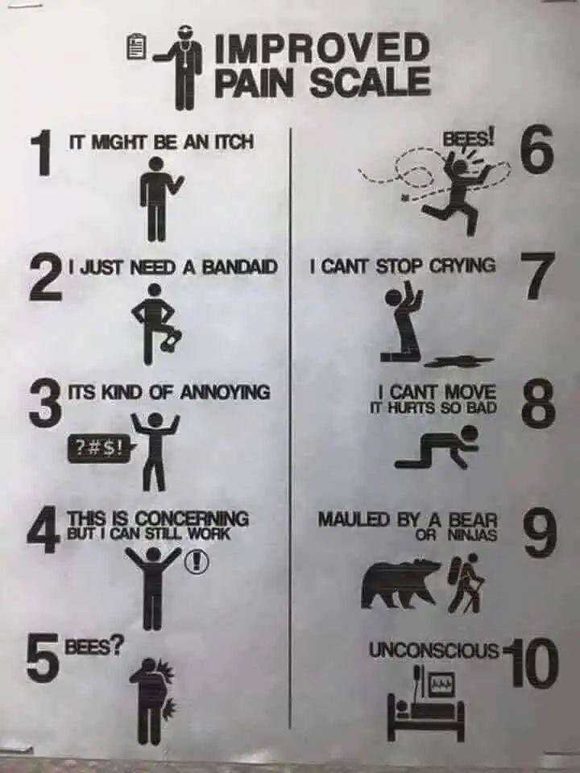
ORDINAL DATA
Ordering or ranking (e.g. user preferences)
No set distance between them
We can compare less than or greater than but should not calculate the mean.
Approximately how many emails do you receive a day?
None
1-5
6-25
26-100
More than 100
Notes:
Ordinal data is like categorical data in that we give names to data types, but the difference is we can ORDER them. However, there is no set difference between them.
The main limitation of ordinal data is that the interval is not equal between different points on this scale. In the example just cited, there is no innate sense of how much more painful getting mauled by a bear is than being stung by bees. Likewise, in the email example, 26-100 is clearly more than 6-25, but you can’t calculate the average of this kind of data. Or you CAN, but it’s meaningless to do so.
There are five rankings according to the number of e-mail messages received per day. It is a matter of choice whether to solicit data in this manner or, in the alternative, to ask for an estimate of the number of e-mail messages received per day. It will depend on how the data are used and analyzed.

Slide 6
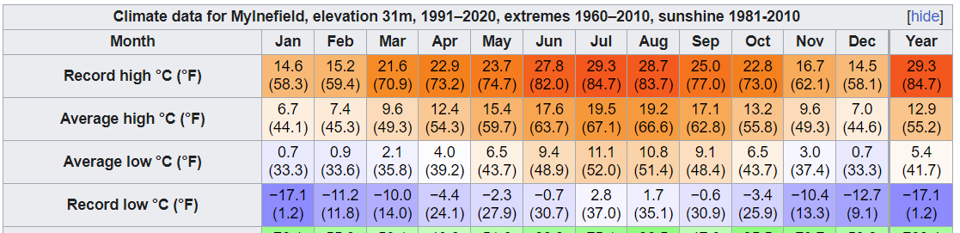
INTERVAL DATA
Equal distances between adjacent values, but no absolute zero.
Can calculate mean values now (mean high July temperature was 22℃, average Mensa IQ is 155)
Still cannot calculate ratios (20℃ is not twice as warm as 10℃, a person with 150 IQ is not twice as smart as a person with 75 IQ)
Notes:
INTERVAL data is one up from ordinal data, where we have equal distances between values on the scale, and it’s now meaningful to calculate the average. So, not only do we know that 22 degrees is warmer than 18 degrees and colder than 50 degrees, but we can take the average of 18 and 50 and know that the average of those is 34.
But the key thing is that there is no ABSOLUTE ZERO. Both Fahrenheit and Celsius have an arbitrary zero. Anders Celsius decided that 0 would be the freezing point of water, but we can easily go colder than that. SO because of that, we can’t say that 20 degrees is twice as warm as 10 degrees.
What’s twice as warm as -10 degrees? There’s no way to calculate ratios.

Slide 7

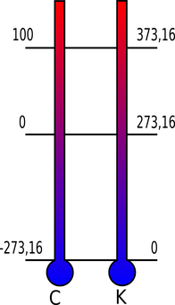
RATIO DATA
Improved by normalisation per something, e.g. words per minute, score per dart
Equal distance and an absolute zero. We can include things like time, but also counts, e.g. number of errors, clicks, gaze shifts…
We can calculate:
Mean
Range
Variance
Standard Deviation
Kelvin has an absolute zero (ratio)
Celsius does not (interval)
Notes:
Ratio data is the MOST sophisticated of our data types. So now not only do we have a scale, and equal distances between the things on the scale, but we also have an ABSOLUTE ZERO. A zero that makes sense. For example, the Kelvin scale of temperature has an absolute zero because that IS the absolute coldest something can be because the atoms stop moving. Therefore we can reasonably say that 200K is twice as warm as 100K.
Time taken is a good example relevant to research studies. Time has a 0, before a study starts, and so we can say that someone is twice as quick as someone else, or made four times as many errors, or whatever.
Now we can improve on the reporting of this kind of data by NORMALISATION, that is, putting everything on the same scale. another example, let’s say two errors were committed while entering a 50-character phrase of text. Reporting the occurrence of two errors reveals very little, unless we also know the length of the phrase.
Even so, comparisons with results from another study are difficult. (What if the other study used phrases of different lengths?) However, if the result is reported as a 2 / 50 = 4% error rate, there is an immediate sense of the meaning, magnitude, and relevance of the human performance measured,

Slide 8
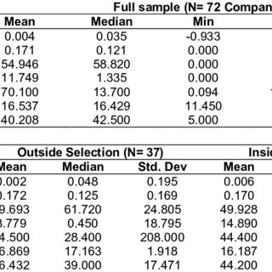
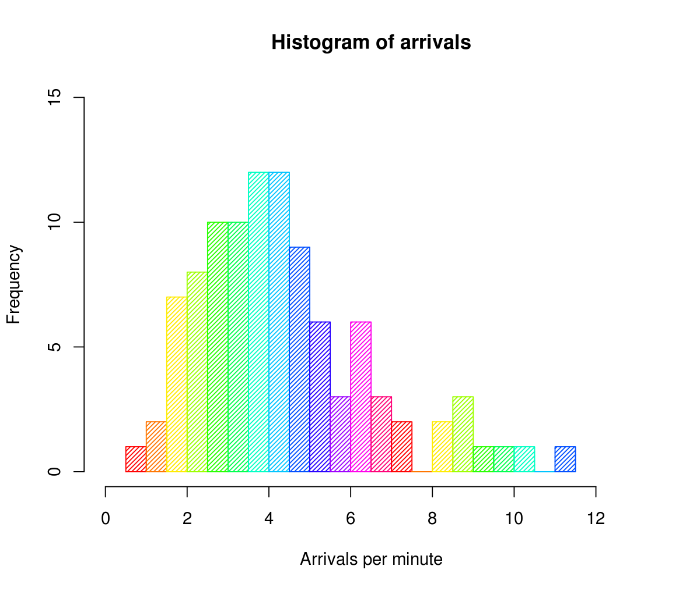
DESCRIPTIVE STATISTICS
Summarise (describe) our data in a meaningful way (numerically + visually)
Measures of…
- central tendency
- spread
- distribution
Tells us everything about our data
Can’t draw conclusions beyond that data
Notes:
There are two main ‘types’ of statistics we can distinguish – the first of which is ‘descriptive statistics’. These are facts and numbers that we can use to summarise (or describe) our set of data. They can be used to get a handle on our data both as numbers, but also as graphs and charts. Often you’ll see statistics reported in tables, but these can also take the form of visualisations like this histogram – one of the many types of visualisation we’ll look at in these weeks of the module.
Descriptive statistics tell us things like what the ‘centre’ of our data is, which we’ll cover in the next video, as well as how spread apart or distributed our data is, which we’ll cover in the video after. So I won’t go into the details here, but what’s important to know is that, while descriptive statistics can tell us everything we’d want to know about our collected data, they ONLY tell us about that data. That is, we can’t infer any general conclusions BEYOND that data.

Slide 9





sample
INFERENTIAL STATISTICS
Draw conclusions (inferences) about a population from our collected data
Our data is a sample of the population of interest
Useful for when the entire population is too difficult to collect data from (i.e., most of the time)!
inferential statistics
population
Notes:
Which is where ‘inferential statistics’ come in. We use this type of statistics to make inferences about a larger population based on a smaller sample.
As an example, you might have heard the old slogan for Whiskas cat food (8 out of 10 cats prefer Whiskas). They didn’t need to test every single cat in the UK to be able to make this claim. Instead, they selected a much smaller sample, and from this could draw the conclusion that 80% of cats are likely to prefer Whiskas over other cat food.
Inferential statistics can also be used to test a hypothesis – for example, if we wanted to know whether there’s a significant difference in academic performance between males and females, or we wanted to see whether the divorce rate in Maine correlates significantly with the per capita consumption of margarine, we would use inferential statistics to say whether we can accept or reject our hypothesis.
But of course, as this example suggests, we have to be very careful about the conclusions we draw from statistics. If we don’t collect our data correctly, or we visualise it in a weird way, or we run the wrong sort of analysis on it, then we can be misleading – either accidentally or deliberately.

Slide 10
PREPARE
ANALYSE
CONCLUDE
Notes:
In the course textbook, Triola describes the need to develop ‘statistical thinking’. This is the ability to see the big picture, to be able to consider contextual factors, and to generally make sense of results. This is completely different to being able to do complex calculations, and certainly more important.
There are three main stages in the statistical thinking process – Prepare, Analyse, and Conclude, which we’ll go through in order.

Slide 11
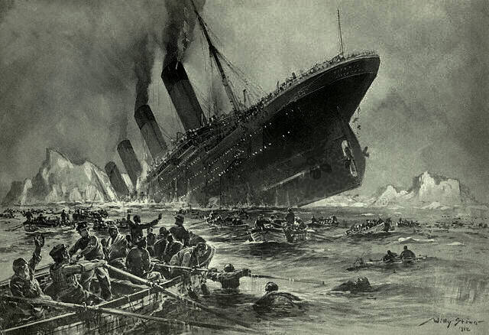

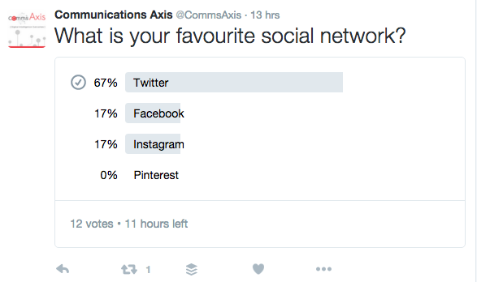
PREPARE
Context
What is this data? Why was it collected?
Source
Is this data from a reputable, unbiased source?
Sampling method
Was the data collection method unbiased?
Notes:
In the ‘preparation’ stage, before we do any sort of analysis on our data, we need to consider the context, the source, and the sampling method. If anything seems wrong with how or why the data was collected, then it might not be worth analysing in the first place.
First, we should consider the context of our data set. What is the data, why was it collected, and has it been collected in such a way that it suggests there might be a relationship? As an example, the application that we’re going to be using in the labs, R, contains a dataset about Titanic passengers. The data was collected as part of the investigation into the ship’s sinking, and this particular dataset contains the class, age, and gender of each passenger, suggesting there might be a relationship between these variables and whether they lived or died.
The source of our information is critical, too. Our Titanic data was collected from the British Board of Trade, who are likely to be a reliable source who aren’t going to profit from the data in any way. Contrast this with an article in the Journal of Nutrition from 2000 that described the health benefits of chocolate consumption, with authors and funding from Mars Incorporated. This doesn’t necessarily mean we can’t trust the data, but we might want to be cautious about the conclusions drawn.
Finally, we also want to make sure that the sampling method itself was unbiased. Typically this is best done through a ‘random sample’ where researchers will randomly select participants to be the ‘sample’ from the population of choice. Where this can go wrong is if a ‘voluntary response sample’ is chosen. This is where participants actively choose to be part of a study, much like in the polls you see on social media. People who volunteer to answer are not likely to represent the population that we want to get a hold of.

Slide 12
sample
SAMPLE WISELY
REPRESENTATIVE SAMPLE
A sample which has the same relevant characteristics as the population it is drawn from.
population
“If sample data are not collected in an appropriate way, the data may be so useless that all statistical analysis on it is completely pointless!”
Notes:
Following on from this, when we’re doing inferential statistics, it is CRUCIAL that our sample is ‘representative’. A representative sample is that which accurately represents the population that we are interested in. If we were interested in the cat food preferences of all UK cats, but our sample only consisted of tigers in Edinburgh zoo, then we would have a biased sample that doesn’t represent the typical UK household cats.
In his book, Triola warns of this, that if we don’t collect our sample data carefully and appropriately, then there’s no point in moving on to the analysis and conclusion phases in the first place.

Slide 13
AN EXAMPLE SAMPLE
RESEARCH QUESTION: What proportion of adult UK citizens are smokers?
DATA VALUES
Categorical. Each data value is either Smoker or Non-Smoker.
POPULATION
Smoker/Non-Smoker categorisation of every adult UK citizen.
SAMPLE
Answers to “Are you a smoker?” from 100 randomly selected UK adults.
REPRESENTATIVE?
We don’t know this
But we can assume so
A random sample is usually good enough
Notes:
As an example, assume our research question is interested in finding out what proportion of UK adults are smokers?
We can get a ‘simple random sample’ by asking 100 randomly selected UK adults. Will this be a representative sample? We can’t know for sure. It may be that, in getting a random sample, that we get too many men, or too many people from a particular city, or some other bias…but a random sample like this is usually ‘good enough’ for us to assume it is representative.
However, the smaller our sample is, the more likely it is to be biased. If we only sample 4 people, it is much more likely that we’ll sample 4 men, or 4 Londoners, or 4 elderly people. A good sample size is important to mitigate these sorts of biases.

Slide 14
ANOTHER EXAMPLE SAMPLE
RESEARCH QUESTION: What is the US population’s favourite meat?
DATA VALUES
Categorical (Chicken/ Beef / Pork / Turkey / Lamb / Other)
POPULATION
Meat categorisation of all US citizens.
REPRESENTATIVE?
No! A voluntary response sample is likely to have a special interest in the topic.
Strong potential for bias.
Lack of coverage.
SAMPLE
Answers collected from a voluntary online survey on the KFC website that asks the question “What is your favourite meat?”

Slide 15
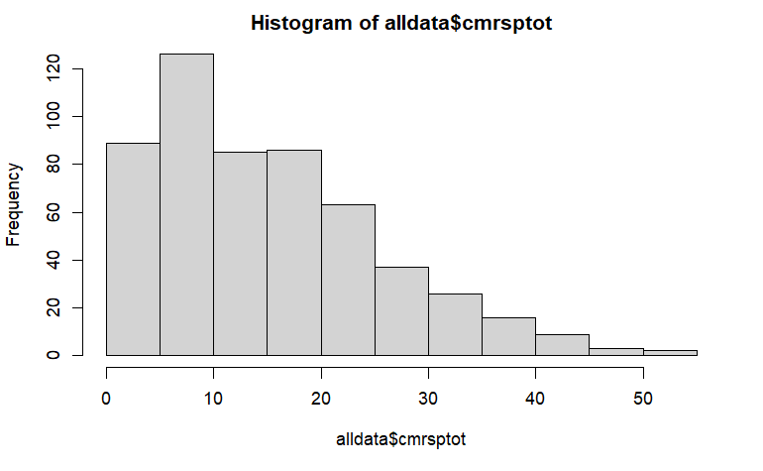

ANALYSE
GRAPH AND EXPLORE
Visualise the data in some way to allow exploration
APPLY STATISTICAL METHODS Numbers will confirm (or deny!) our explorative thoughts
Notes:
Once we’ve decided that our data is probably sound and that we can get some meaningful results from it, we can then move on to the analysis phase. Analysis of data involves both applying statistical calculations to get some numbers about our data (I’ll discuss some of these in the next videos) but also involves just getting the data into a representation that makes it easier for us to see what’s going on.
One thing we must be aware of is that both numbers and visualisations can be misleading. I’ll cover some additional examples of this in the tutorial, but a big part of developing ‘statistical thinking’ skills is learning how to interpret our analyses and ensure that our conclusions are not over-enthusiastic or just plain wrong.

Slide 16
CONCLUDE
STATISTICAL SIGNIFICANCE Are our results likely to have occurred by chance?
PRACTICAL SIGNIFICANCE
Who cares? Are the effects large enough to be used in any meaningful way?
Notes:
In drawing conclusions from our data, there are two types of ‘significance’ that we look for – statistical significance, and practical significance.
If our results are ‘statistically significant’, it means that they are very unlikely to have occurred purely by chance. This is something we can calculate using inferential statistics, from which we can get the probability that the results we have are a consequence of the variable(s) we’re interested in, or a consequence of pure random chance.
PRACTICAL significance is something we can’t determine through calculations, and instead reflects whether we can make practical real-world use of our results. For example, let’s say we have two groups of 1000 people. One group does the keto diet for 3 months, the other group doesn’t. The keto group loses an average of 2kg more than the non-keto group. This might be statistically significant, but someone on a diet for 3 months would probably want to lose more than 2kg, so in practical terms, the results don’t mean much.

Slide 17
STATISTICAL THINKING
Seeing the big picture:
- Why was the data collected?
- Who collected it?
- How was it collected?
- What does it look like?
- Can we conclude anything significant?
Less about calculating/programming
More about common sense
Notes:
In summary, I’ve introduced some important elements of making sense of the data we collect and analyse.
Statistics is far more than just crunching numbers and plotting graphs – it’s critical that we see the ‘big picture’ of our data. In developing statistical thinking, you should make sure to consider the source of data, how it was collected, whether there are any possible biases, what it looks like both visually and numerically, and whether anything ‘practical’ can be derived from our analysis.
In the next couple of videos I’ll talk about how to do some simple descriptive statistics on data, and some of the pitfalls we have to be careful of in doing so.

